Slide 1
DVWA TEAM PROJECT
Robert Atwood | Kahla Anderson | Joshua Atalla

Slide 2
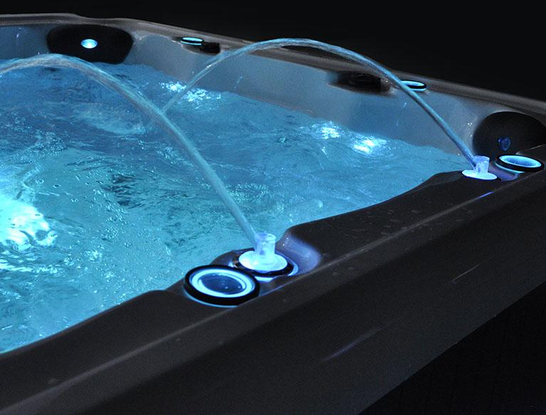
BUSINESS GOALS
Our goal is to create an online store for hot tubs. We want our users to be able to select from a variety of brands based on their preferred functions and features. The users can select what features they want and the site will pull up any one of our warehouse models that fits their specifications.

Slide 3
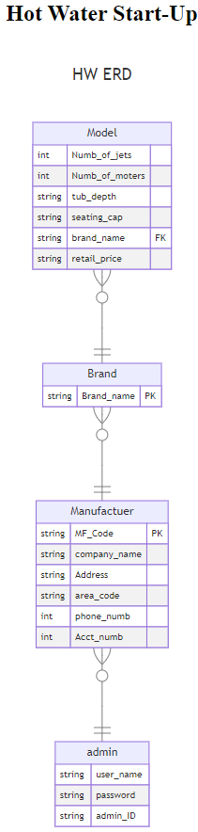
ERD
The Manufacturer model entity represent companies that produce spas. Each manufacturer has unique details captured by the attributes above.
The Brand entity represents different lines or series of spas that a manufacturer produces. Each brand belongs to one manufacturer.
The Model entity represents specific spa models that fall under different brands. Each model is unique and has specific characteristics like the number of jets, motors, etc.

Slide 4
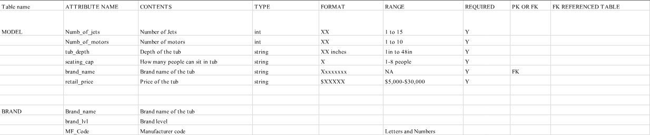
DATA DICTIONARY
This data dictionary provides the structure and details needed for creating and managing these two tables within a database, ensuring data integrity and proper relationships between the spa pool models and their respective brands.

Slide 5
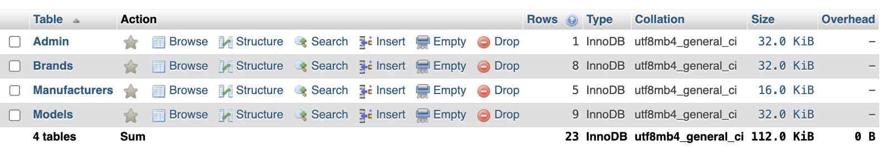
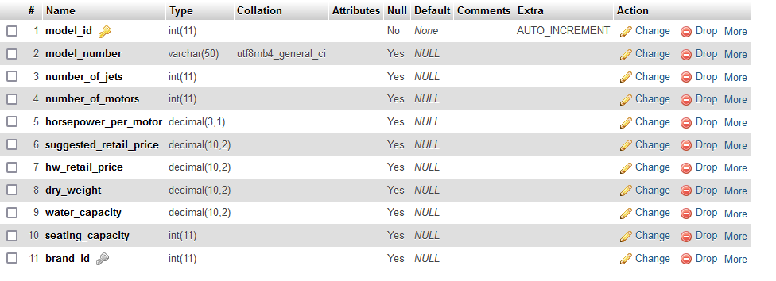
DATABASE CREATION
The database table is designed to manage comprehensive information about spa pool models, supporting features that allow the application to provide detailed comparisons and recommendations.
All the columns are set to allow NULL values meaning they can be left empty unless specified otherwise. The table is also structured to store essential details about different spa pool models, including technical specifications, pricing, and brand info.

Slide 6
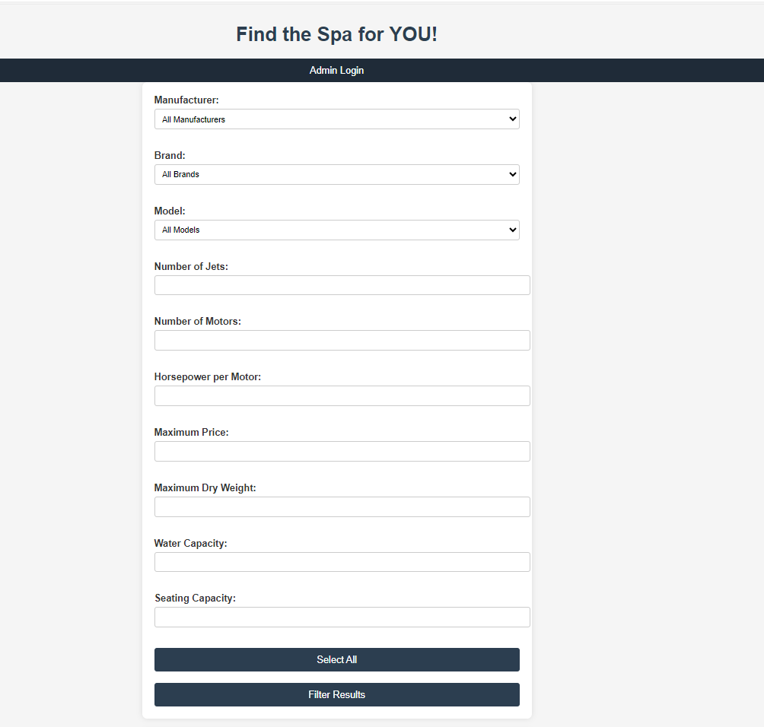
HTML PAGE
This HTML page will allow the user to select many different things, and it gets very specific.
You’re able to select the manufacturer the tub will be from, the brand and model, the number of jets and motors, how much horsepower each motor will have, the maximum price of the tub, how much water the tub can carry, as well as how many people can be seated in the tub.

Slide 7
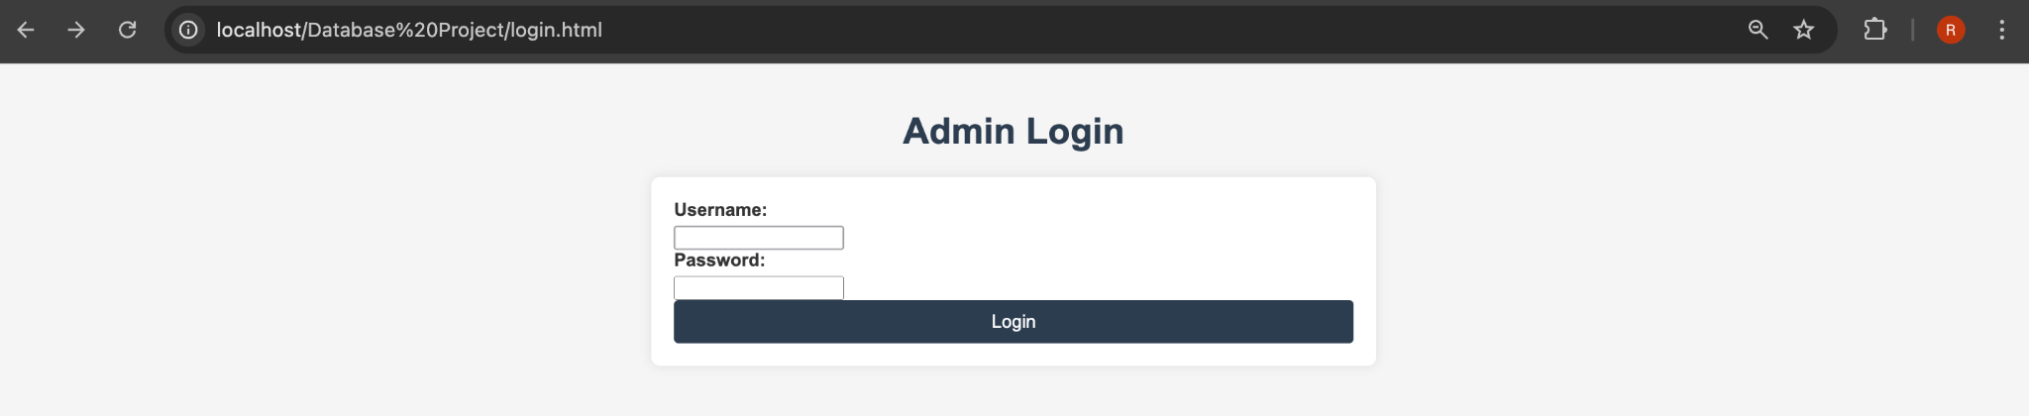
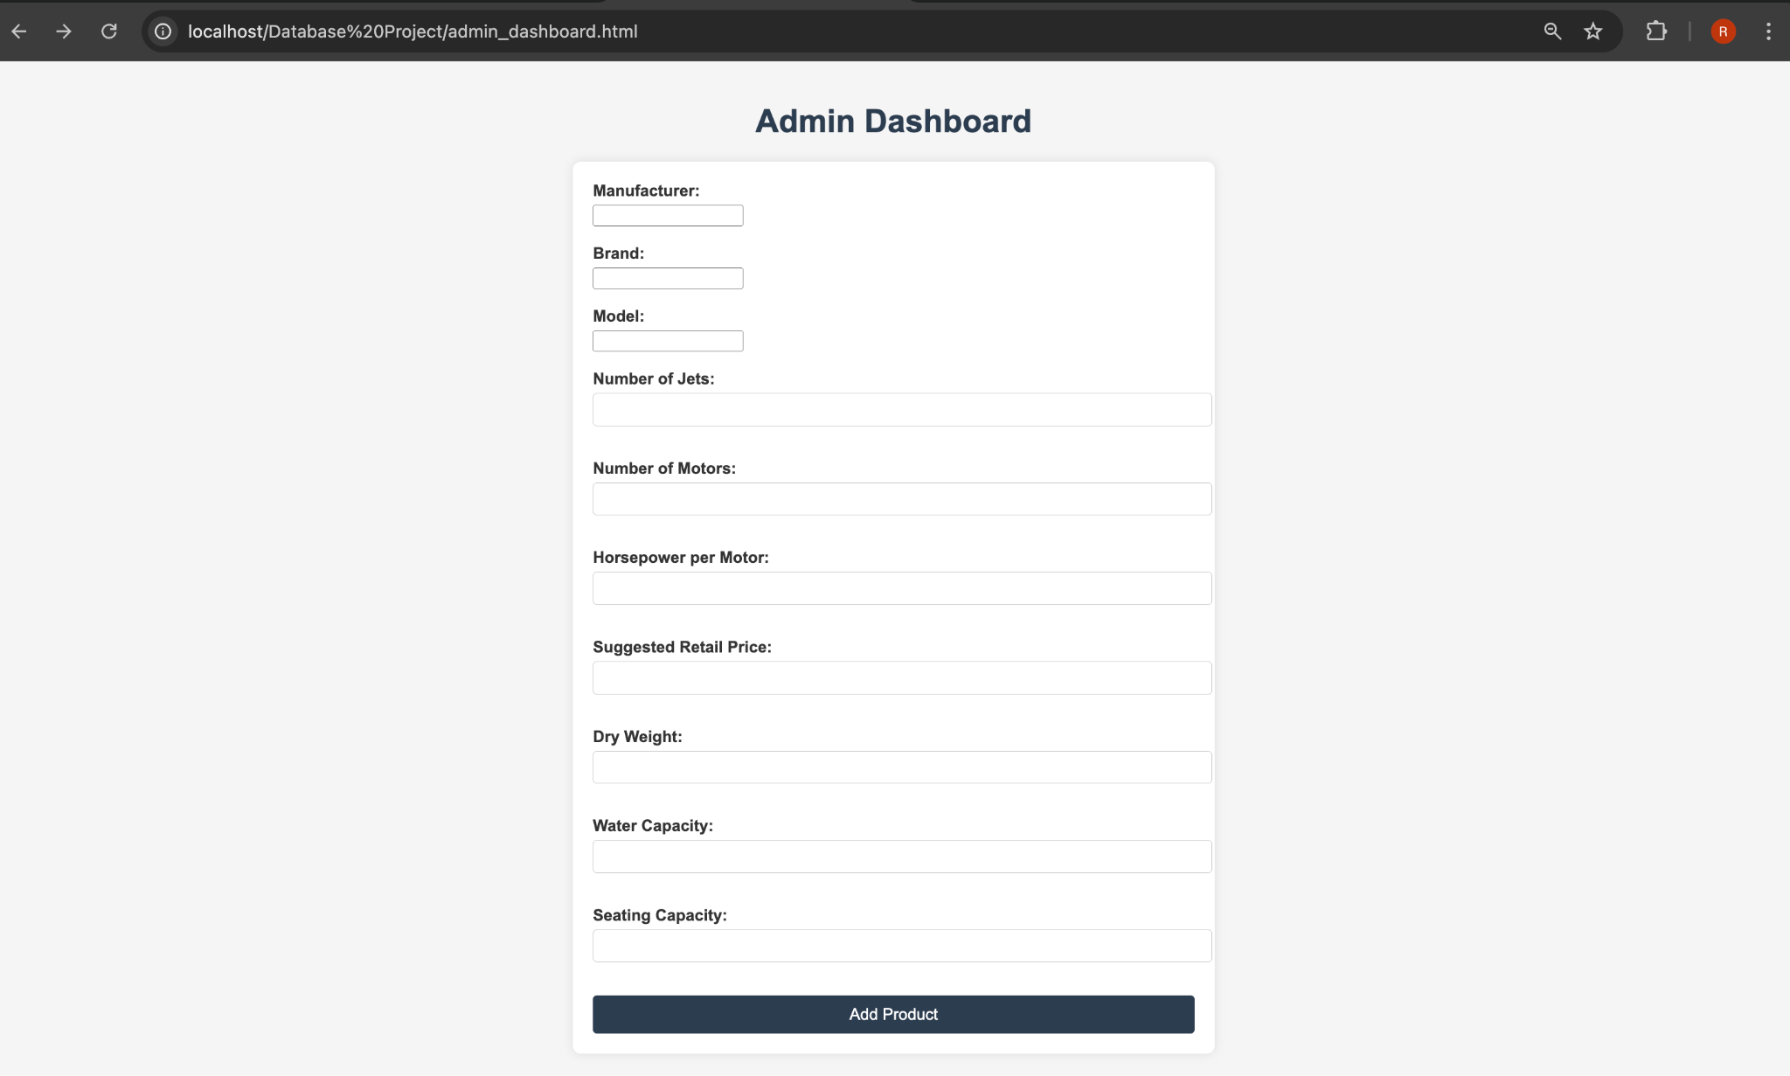
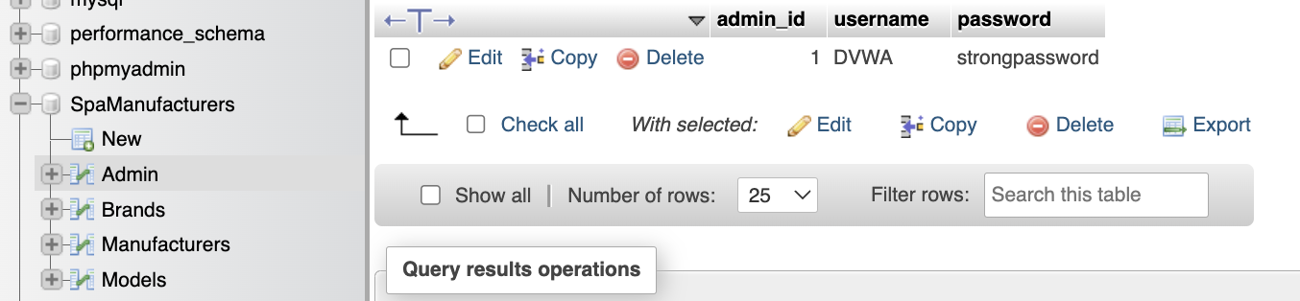
ADMIN PERMISSIONS
The ability to write to our SpaManufacturer Database requires you to login with a username and password that our “login.php” fetches from the Admin table of our database.
If the username and password exist in that table than you are redirected to the admin_dashboard html that uses a separate php file “add_product.php” to write new Spa’s to the database.

Slide 8
DEMO

Slide 9
QUESTIONS

